Slide 1

Exploring
#6 Express Module

Slide 2
Express
Express is a minimal and flexible Node.js web application framework that provides a robust set of features for web & mobile applications.
(See https://expressjs.com).
First, create a project directory then
$ npm init
Installation
$ npm install express --save

Slide 3
Response to a
Create Server
satu.js
var express = require('express');
var app = express();
app.listen(3000);
// Listening port 3000
Run node satu
Open localhost:3000

Slide 4

Nodemon
Nodemon is a tool/utility that will monitor for any changes in your source and automatically restart your server. Just use nodemon instead of node to run your code, and now your process will automatically restart when your code changes.
See https://nodemon.io.
Installation
$ npm install -g nodemon
Open & run source with Nodemon
$ nodemon namaFile.js
Restart
$ rs

Slide 5
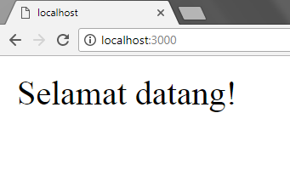
Response to a
GET Request
var express = require('express');
var app = express();
app.get('/', function(req, res){
res.send('Selamat datang!');
})
// GET request
app.listen(3000);
// Listening port 3000

Slide 6
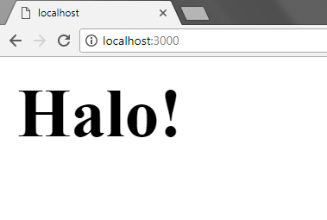
Serving HTML
var express = require('express');
var app = express();
app.get('/', function(req, res){
res.send('<h1>Halo!</h1>');
})
// GET request
app.listen(3000);
// Listening port 3000

Slide 7
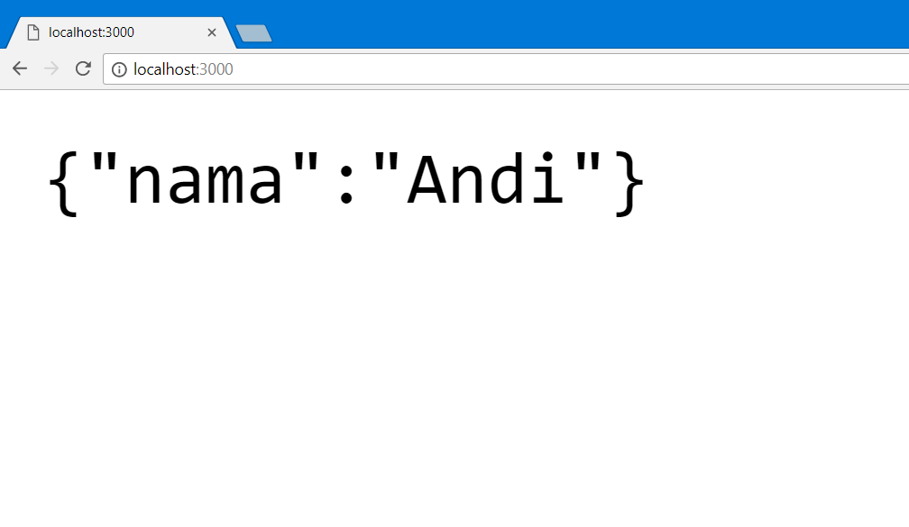
Serving JSON
var express = require('express');
var app = express();
app.get('/', function(req, res){
res.json({"nama":"Andi"});
})
// GET request
app.listen(3000);
// Listening port 3000

Slide 8

Routing
/beranda
/profil
/berita
/galeri
/tentang
/kontak

Slide 9
Response to a
GET Request
var express = require('express');
var app = express();
app.get('/', function(req, res){
res.send('Selamat datang!');
})
// GET request
app.listen(3000);
// Listening port 3000

Slide 10
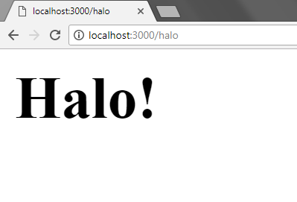
Response to a
Static Request
var express = require('express');
var app = express();
app.get('/halo', function(req, res){
res.send('<h1>Halo!</h1>');
})
// GET static request
app.listen(3000);
// Listening port 3000

Slide 11
Response to a
Dynamic Request
var express = require('express');
var app = express();
app.get('/id/:nama', function(req, res){
res.send('Request ID '+req.params.nama);
})
// GET dynamic request w/ parameter nama
app.listen(3000);
// coba buka:
// localhost:3000/id/Lintang
// localhost:3000/id/Andi

Slide 12
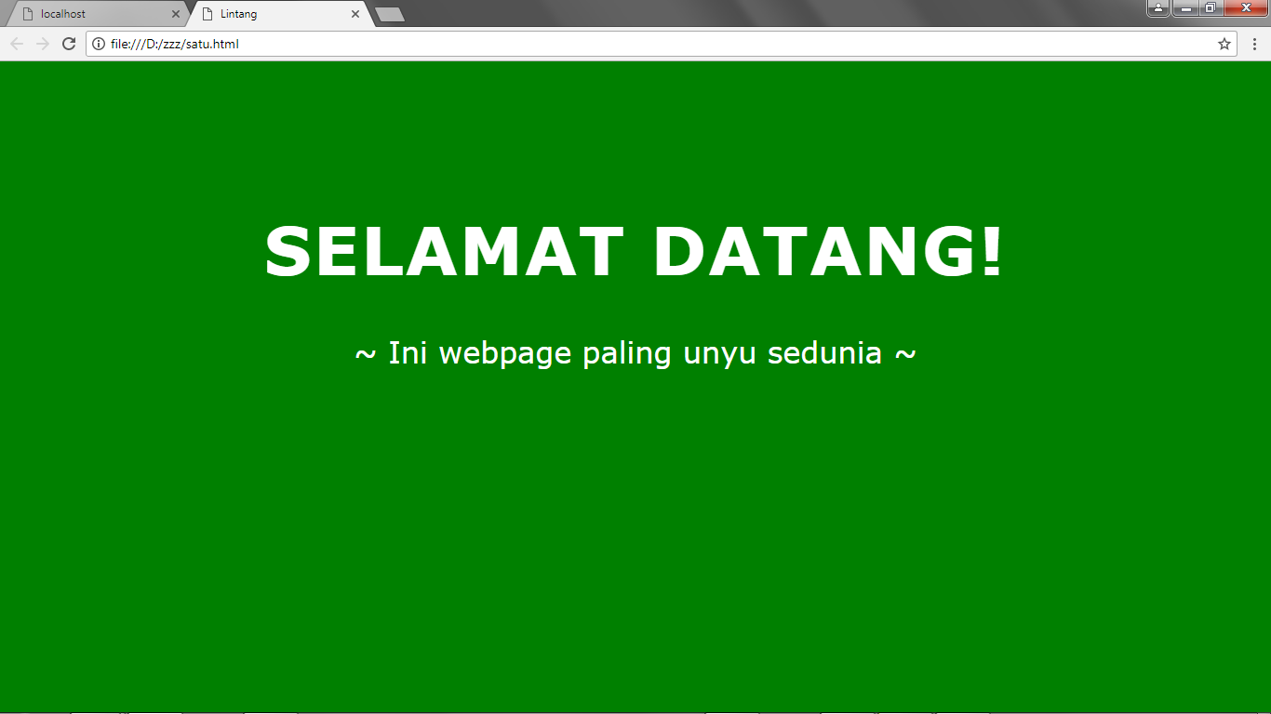
Serving HTML File
#Static Req & Res
satu.html

Slide 13
Serving HTML File
#Static Req & Res
satu.html
<!DOCTYPE html>
<html>
<head><title>Lintang</title>
<style>
body{background:green; font-family:verdana; color:white; padding:150px;}
h1{font-size:72px; text-transform:uppercase; letter-spacing:2px; text-align:center;}
p{font-size:32px; text-align:center;}
</style>
</head>
<body>
<h1>Selamat Datang!</h1>
<p>~ Ini webpage paling unyu sedunia ~</p>
</body>
</html>

Slide 14
Serving HTML File
#Static Req & Res
satu.js
var express = require('express');
var app = express();
app.get('/', function(req, res){
res.sendFile(__dirname + '/satu.html');
})
app.listen(3000);
* satu.html & satu.js ada dalam 1 folder!

Slide 15
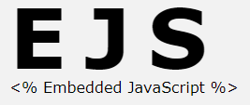
Embedded
JavaScript
EJS is a package of client side templating language (view engine) that was originally part of JavaScriptMVC, which has now been replaced by DoneJS. EJS combines data & a template to produce HTML. JavaScript between <% %> will be executed. JavaScript between <%= %> adds HTML to the result (see embeddedjs.com).
Installation
npm install ejs --save

Slide 16
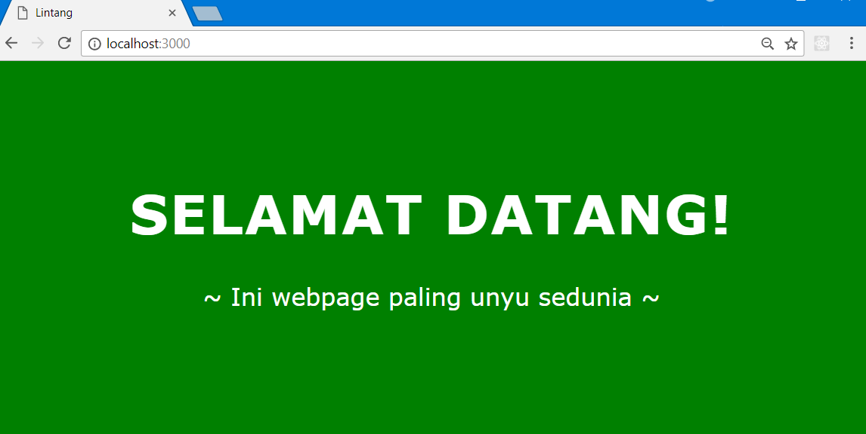
Serving EJS File
#Static Req & Res
localhost:3000/

Slide 17
// Buat ‘satu.ejs’ dalam folder ‘views’
satu.ejs
<!DOCTYPE html>
<html>
<head><title>Lintang</title>
<style>
body{background:green; font-family:verdana; color:white; padding:150px;}
h1{font-size:72px; text-transform:uppercase; letter-spacing:2px; text-align:center;}
p{font-size:32px; text-align:center;}
</style>
</head>
<body>
<h1>Selamat Datang!</h1>
<p>~ Ini website paling unyu sedunia! ~</p>
</body>
</html>
Serving EJS File
#Static Req & Res

Slide 18
Serving EJS File
#Static Req & Res
satu.js
var express = require('express');
var app = express();
app.set('view engine' , 'ejs');
// buat folder ‘views’!
app.get('/', function(req, res){
res.render('satu');
})
// merujuk ke file ‘satu’ dalam views.
app.listen(3000);

Slide 19
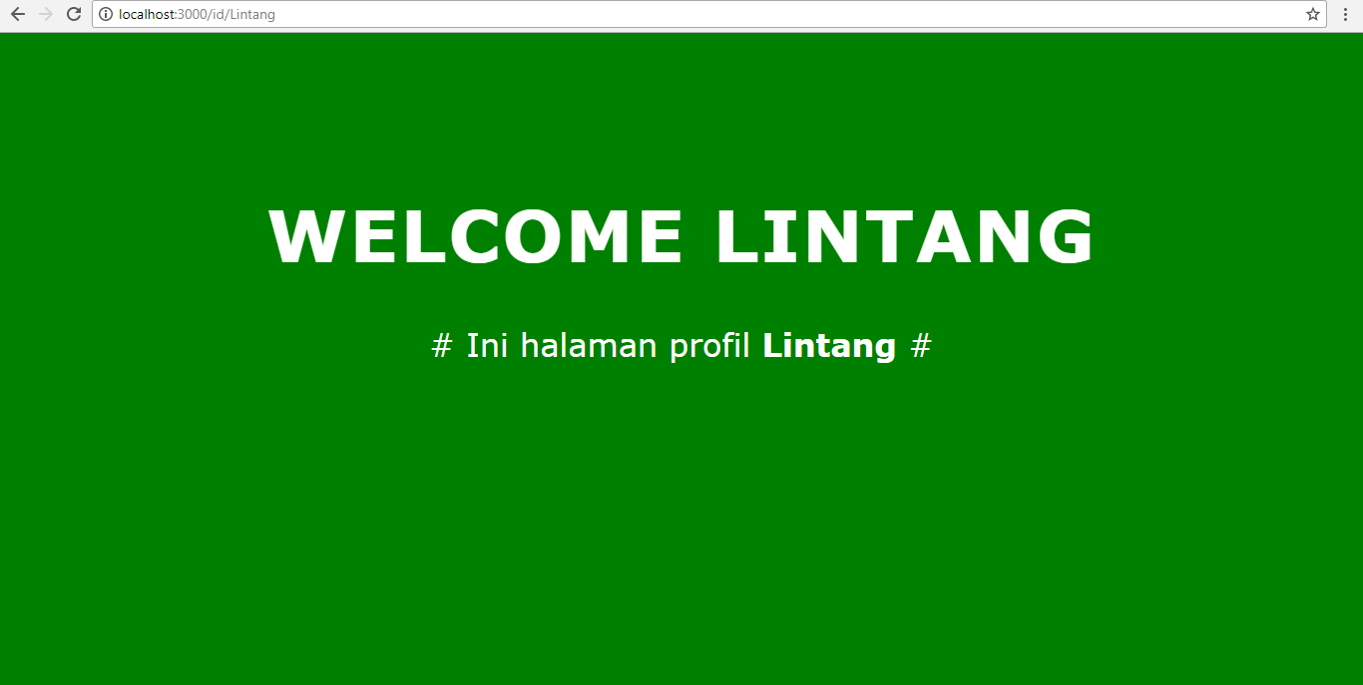
Serving HTML File
#Dynamic Req & Res
localhost:3000/id/Lintang

Slide 20
// Buat ‘satu.ejs’ dalam folder ‘views’
satu.ejs
<!DOCTYPE html>
<html>
<head><title>Lintang</title>
<style>
body{background:green; font-family:verdana; color:white; padding:150px;}
h1{font-size:72px; text-transform:uppercase; letter-spacing:2px; text-align:center;}
p{font-size:32px; text-align:center;}
</style>
</head>
<body>
<h1>Welcome <%= orang %></h1>
<p># Ini halaman profil <b><%= orang %></b> #</p>
</body>
</html>
Serving HTML File
#Dynamic Req & Res

Slide 21
Serving HTML File
#Dynamic Req & Res
satu.js
var express = require('express');
var app = express();
app.set('view engine' , 'ejs');
// buat folder ‘views’!
app.get('/id/:nama', function(req, res){
res.render('satu', {orang:req.params.nama});
})
// merujuk ke file ‘satu’ dalam views.
app.listen(3000);

Slide 22
Serving HTML File
#Dynamic Req & Res
localhost:3000/id/Lintang

Slide 23
Inject an Object
satu.js
var express = require('express');
var app = express();
app.set('view engine' , 'ejs');
app.get('/', function(req, res){
var orangjs = {nama:'Andi', usia:24};
res.render('satu', {orangejs: orangjs});
})
app.listen(3000);

Slide 24
Inject an Object
satu.ejs
<body>
<h1>Welcome
<%= orangejs.nama %></h1>
<p># Usia Anda <b>
<%= orangejs.usia %>
</b> th #</p>
</body>

Slide 25
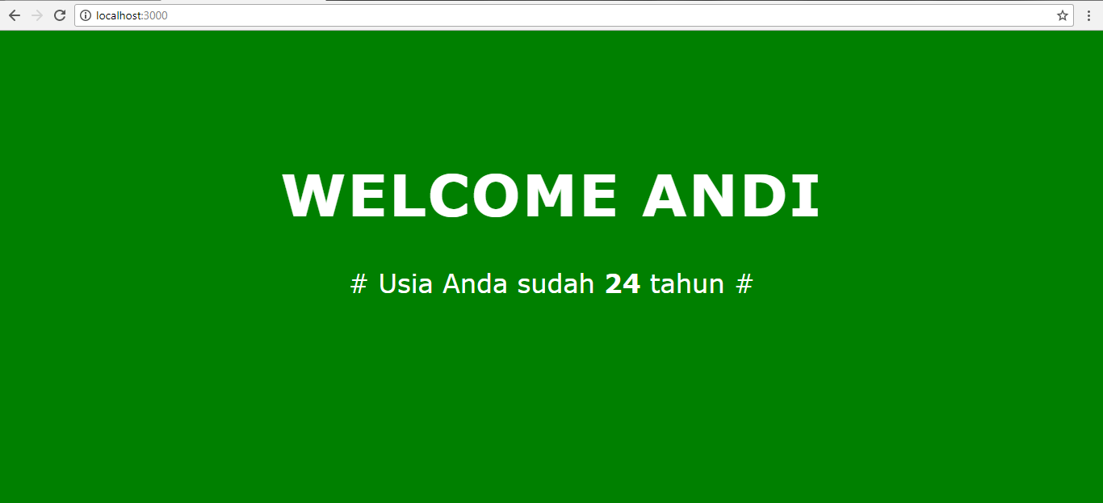
Serving HTML File
#Dynamic Req & Res
Inject an Object
localhost:3000

Slide 26
Inject JS code
satu.js
var express = require('express');
var app = express();
app.set('view engine' , 'ejs');
app.get('/', function(req, res){
var orangjs = ['Adi', 'Budi', 'Caca'];
res.render('satu', {orang: orangjs});
})
app.listen(3000);

Slide 27
satu.ejs
<body>
<h1>Welcome!</h1>
<% for(i=0;i<3;i++){ %>
<p> <%= orang[i]; %> </p>
<% } %>
</body>
Inject JS code

Slide 28
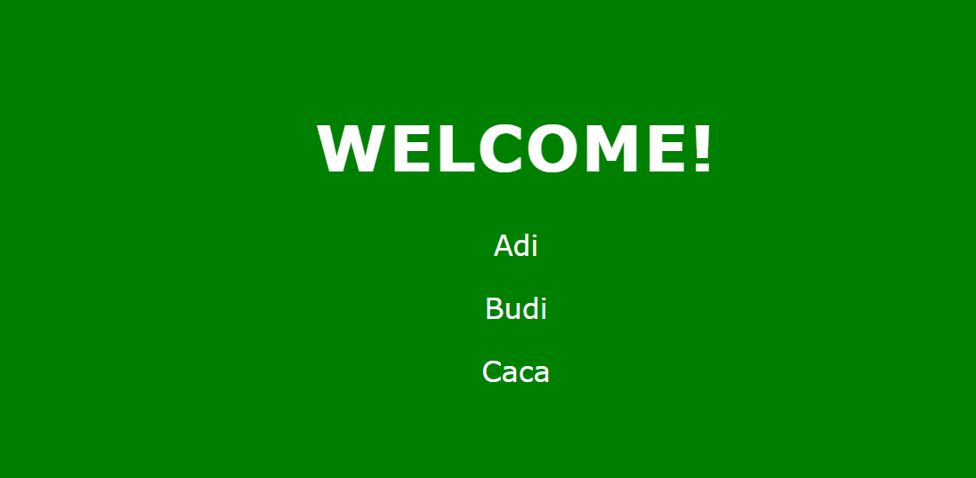
Inject JS code
localhost:3000

Slide 29
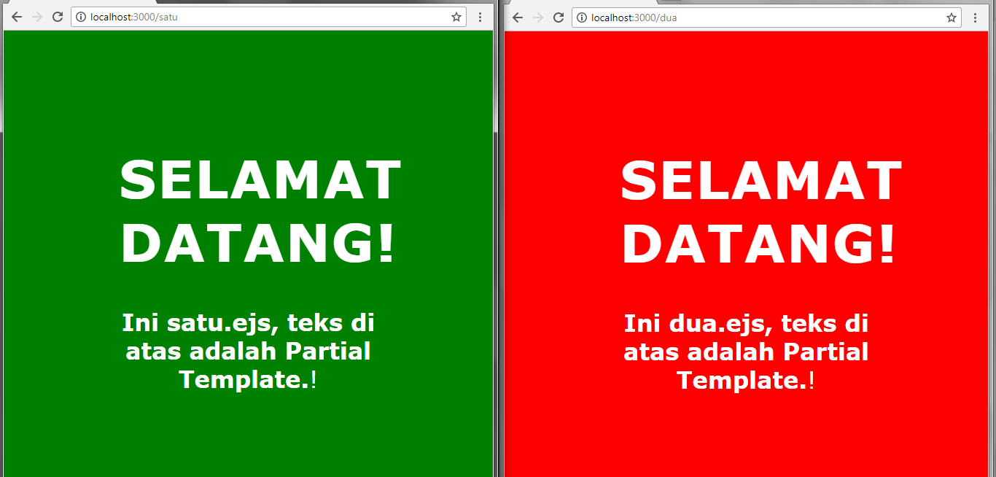
localhost:3000/satu & localhost:3000/dua
Partial Template

Slide 30
Partial Template
judul.ejs
<h1>Selamat Datang!</h1>
// create judul.ejs on dir views/parsial

Slide 31
satu.ejs
<body>
<% include parsial/judul.ejs %>
<b><p>Ini satu.ejs, teks di atas adalah Partial Template</b>!
</body>
Partial Template

Slide 32
dua.ejs
<body>
<% include parsial/judul.ejs %>
<b><p>Ini dua.ejs, teks di atas adalah Partial Template</b>!
</body>
Partial Template

Slide 33
Partial Template
satu.js
var express = require('express');
var app = express(); app.set('view engine', 'ejs');
app.get('/satu', function(req, res){
res.render('satu');
})
app.get('/dua', function(req, res){
res.render('dua');
})
app.listen(3000);

Slide 34
localhost:3000/satu & localhost:3000/dua
Partial Template

Slide 35
Query String
Query string is the part of a uniform resource locator (URL) containing data that does not fit conveniently into a hierarchical path structure.
http://123.com/news?page=2
http://xyz.com/a?x=1234&y=5678

Slide 36
Query to Server
satu.js
var express = require('express');
var app = express();
app.set('view engine', 'ejs');
app.get('/', function(req, res){
console.log(req.query)
res.render('satu');
})
app.listen(3000);

Slide 37
satu.ejs
<body>
<h1>Welcome!</h1>
<p>Selamat datang ~</p>
</body>
Query to Server

Slide 38
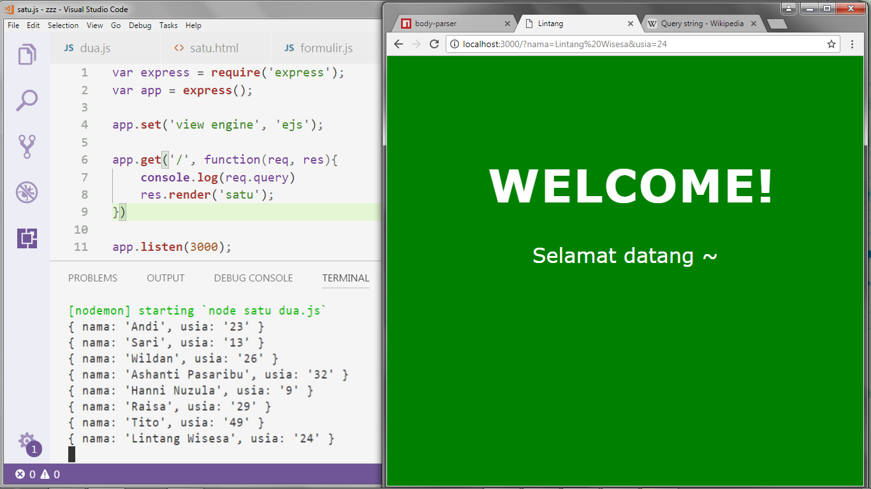
localhost:3000/?nama=Iwa%20K&usia=52

Slide 39
Query to Server
& Res HTML page
satu.js
var express = require('express');
var app = express();
app.set('view engine', 'ejs');
app.get('/', function(req, res){
console.log(req.query)
res.render('satu', {qs: req.query});
})
app.listen(3000);

Slide 40
satu.ejs
<body>
<h1>Welcome!</h1>
<p>Hai kak <b><%= qs.nama %></b>!
<p>Usiamu <b><%= qs.usia %></b> th!
</body>
Query to Server
& Res HTML page

Slide 41
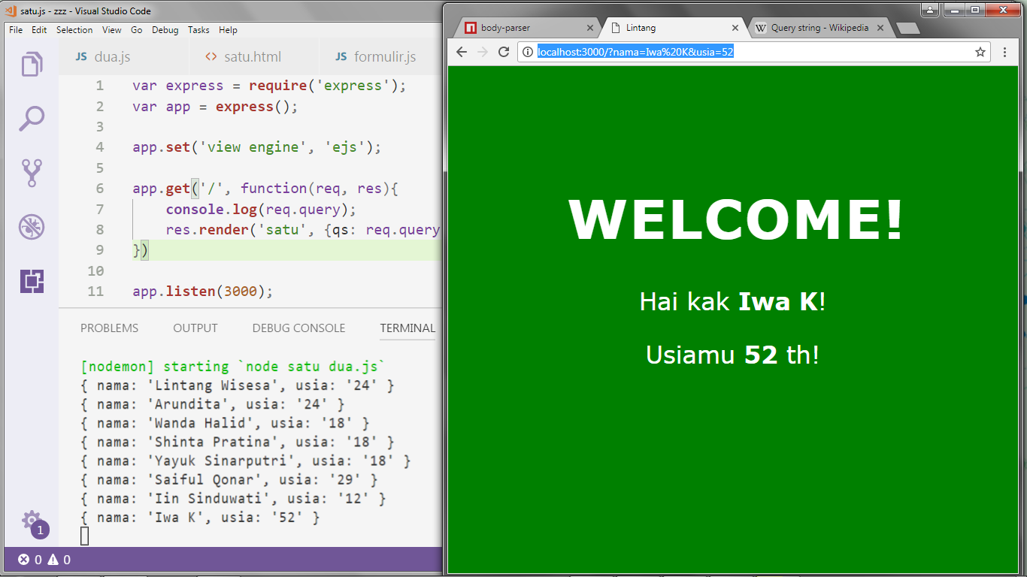
localhost:3000/?nama=Iwa%20K&usia=52

Slide 42
Exploring
#6 Express Module

